Slide 1
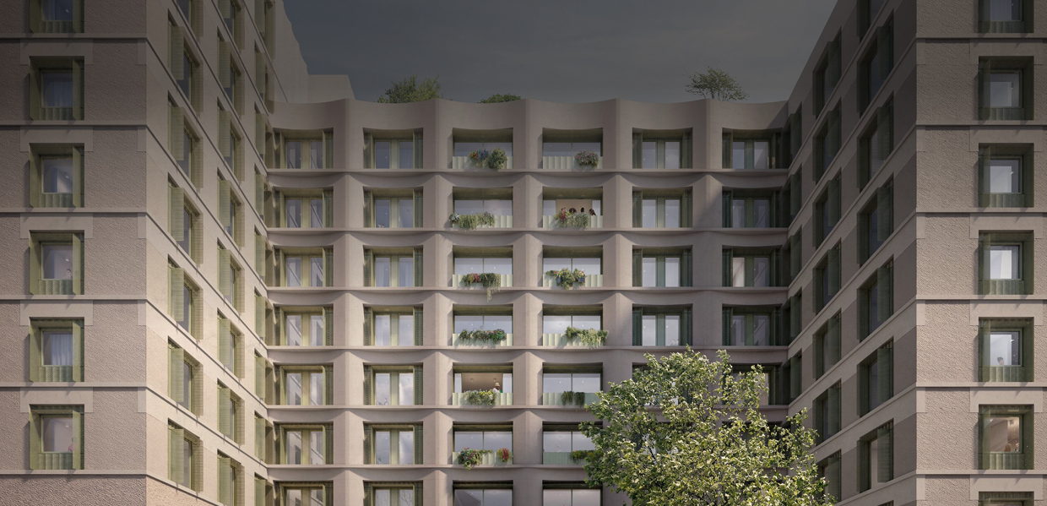

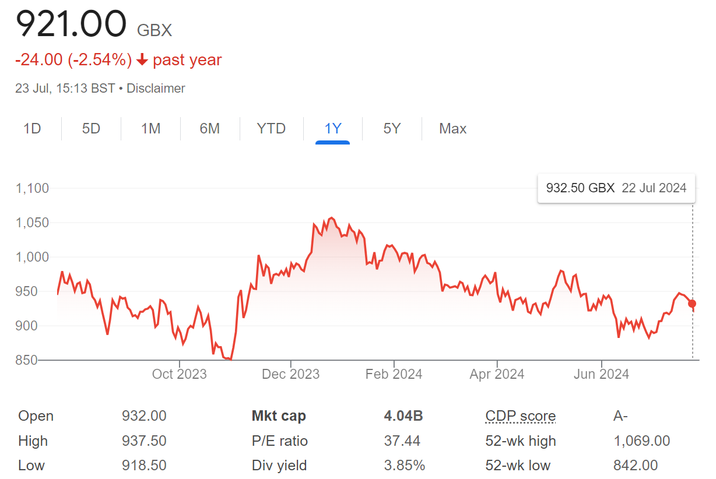






(UTG) | Share price: 932.0p
Market Cap: £4.04bn (as at 23 July 2024)
King’s Place, Borough, London
Unite Students have acquired the land for
a new 444-bed scheme at King’s Place in Borough, London. Full planning consent
has been achieved with delivery expected in time for the 2027/28 academic year.
The UK’s largest owner, manager and developer of purpose-built student accommodation
c. £5.7bn | 151 | 68,000 | 1991
Portfolio | Assets | Beds | Founded
HY 2024 Summary
Adjusted earnings increased by 14% to £125.3m
Strong reservations expected of 98-99%; rental growth at least 7% for 2024/25
Our £250m Newcastle University JV is progressing well and we are confident of securing a second in the next 6-12 months
Record £1.5bn and 8,000-bed pipeline in strongest university cities
Over £90m invested over the past year
Financial Highlights H1 2024
Key Highlights
£5.7bn
UTG share portfolio valuation, up 2.7% on a like-for-like basis
All details below correct as of 30 June 2024
Adjusted earnings:
£125.3m (H1 2023: £110.2m)
Adjusted earnings per share: 28.7p (H1 2023: 27.5p)
Adjusted EBIT margin: 71.6% (H1 2023: 72.9%)
Dividend per share: 12.4p (H1 2023: 11.8p)
EPRA NTA per share: 969p (H1 2023: 928p)
LTV:
26% (H1 2023: 31%)
Net debt:
£1,507m (H1 2023: £1,742m)
12.4p
Interim dividend, up 5% on H1 2023
6,900
Beds committed to delivery through nine full-funded developments
98-99%
Expected strong reservations for 2024/25
£47m
Refurbishments to enhance portfolio
+2.8%
LfL Increase in portfolio valuation (UTG share: 2.7%)

Slide 2
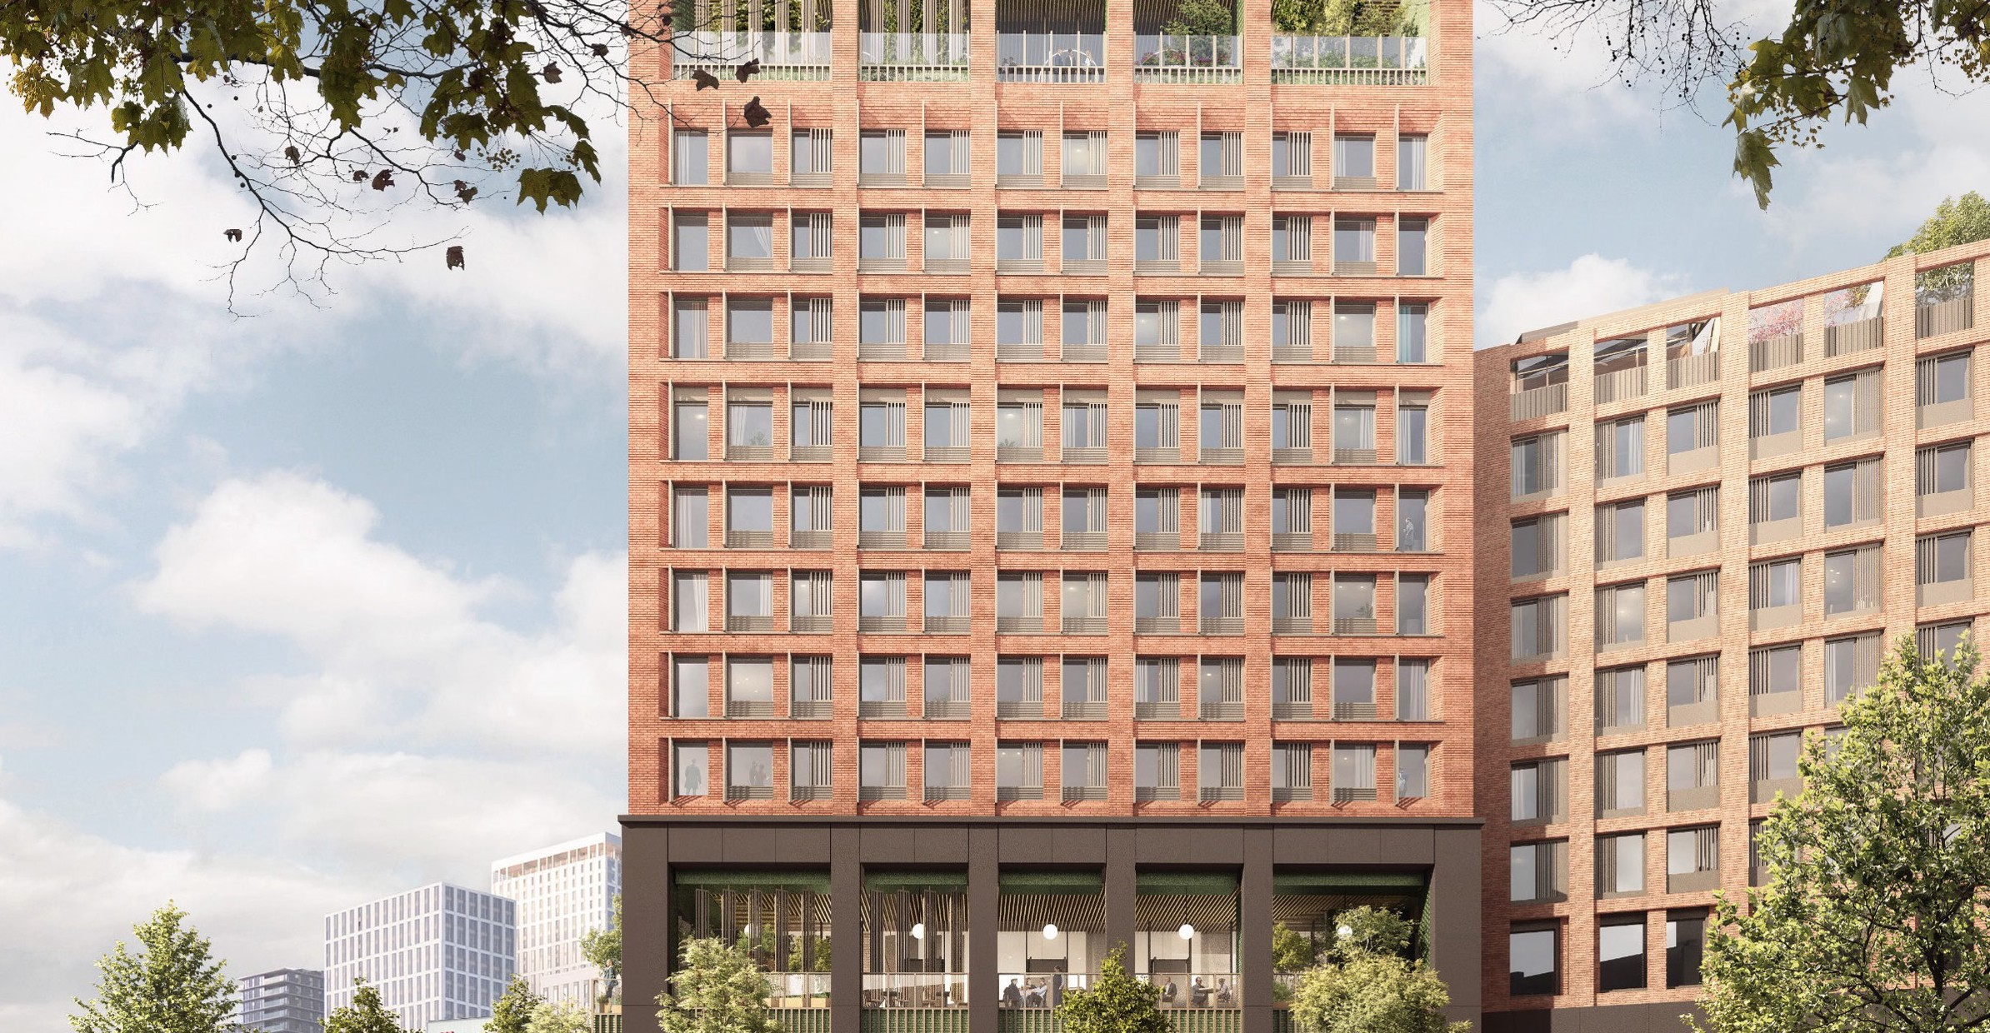

Meridian Square, Stratford, London
During H1 2024, planning approval has been secured for the 952-bed project and Unite Students expect to purchase the site later this year. Delivery is expected in 2028 and will bring, alongside Hawthorne House, Unite’s scale across Stratford to 3,400 beds.
Value-for-money offering
Unite Students’ fixed price, all-inclusive offer continues
to provide real value-for-money
Pricing is comparable to HMOs once bills are included – before allowing for the price certainty on utilities and additional product and service features provided
Unite Students rents will be lower in real terms for the 2024/25 academic year than in 2019/2020
Crucial to our purpose is investing in young people and their future – we recognise the value placed in Higher Education and are trusted providers of PBSA
Constantly looking to evolve our proposition, developing new and innovative ways to meet greater student demand
Balanced approach to rental growth considers the needs of all our stakeholders
University partners and growth
Unite Students is uniquely placed to address the supply-demand imbalance facing universities
Trusted partner – as highlighted by the JV with Newcastle University announced in February
Significant opportunity to become the partner-of-choice for leading universities to help unlock campus potentials to deliver new accommodation
In advanced discussions with leading universities for further strategic partnerships – confident in securing a second agreement in H2 2024
Growing number of attractive investment opportunities with development pipeline at a record £1.5bn in the strongest university cities
News releases
15 July 2024
19 June 2024
13 May 2024
24 April 2024
9 April 2024
27 March 2024
20 March 2024
New optimism among university applicants for post-grad job prospects
London Stock Exchange welcomes Unite Students on 25th anniversary
Disposal of six properties for £184m
Unite Students completes £5.7m refurb of London property
Unite Students receives planning permission for two schemes in London and Bristol
Unite Students builds its first mixed use property in Edinburgh
New Group People Director joins Unite Students
For further information please contact: Sodali & Co
Tel: +44 20 7250 1446
unite@sodali.com Unite Press Office
Tel: +44 117 302 7000

